Slide 1
The Dangers of Sensitive Sectors in FTAs
Alan V. Deardorff
University of Michigan
Lecture 3
Nankai University
March 1, 2016

Slide 2
One More Mega-FTA
TFTA: Tripartite Free Trade Area
  26 countries in Africa
    EAC: East African Community
    SADC: Southern African Development Community
    COMESA: Common Market for Eastern and Southern Africa

Slide 3
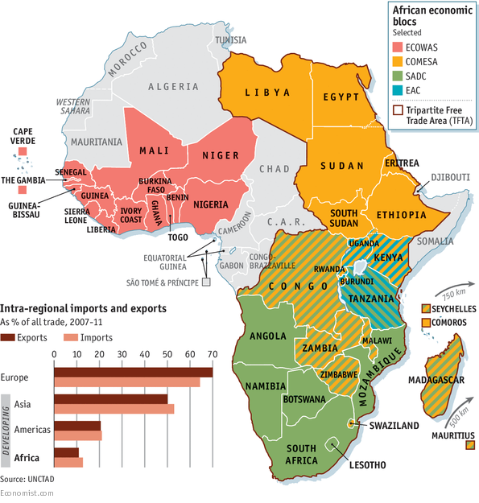

Slide 4
Pros and Cons of all FTAs
Preferential tariff cuts
  Pro: trade creation
    Similar to the classic “gains from trade”
  Cons:
    Trade diversion
    Rules of origin (ROOs)
    Exemption of sensitive sectors
      Sensitive = Most likely to be trade-creating if included

Slide 5
Effects of FTAs
Market-diagram Illustration
  Suppose Country A can import a good from either Country B or Country C at prices
  P_{C} < P_{B}
  And Country A has a tariff greater than the price difference:
  t > (P_{B} − P_{C})
  What happens when Country A forms a PTA with high-cost Country B, lowering its tariff to zero on imports from Country B?

Slide 6
Effects of FTAs
Before FTA
Market in Country A
P
P_{C}+t < P_{B}+t, so
S^{A}
P_{B}+t
A imports from C
P_{C}+t
With FTA
P_{B}
P_{B}< P_{C}+t, so
P_{C}
A imports from B
D^{A}
Q

Slide 7
Effects of FTAs
Market in Country A
FTA of Country A and Country B:
P
S^{A}
Trade Creation
P_{C}+t
a
c
Welfare effects
Producers lose −a
Consumers gain +(a+b+c+d)
Gov’t loses −(c+e)
Net +(b+d)−e
P_{B}
b
d
e
P_{C}
D^{A}
Q
Trade Diversion

Slide 8
Effects of FTAs
Market in Country A
FTA of Country A and Country B:
P
S^{A}
Trade Creation
P_{C}+t
a
c
Implication:
Country A can lose from the FTA in this market, if
e > (b+d)
(as it is in this picture)
P_{B}
b
d
e
P_{C}
D^{A}
Q
Trade Diversion

Slide 9
Effects of FTAs
Sensitive sectors
  Area a is
    The loss to producers
    Part of the gain to consumers
    The main reason why a sector would lobby to be named “sensitive” and excluded from the tariff cut on country B
  See how it, and the gains and losses from PTA, varies with changing costs:

Slide 10
Market in Country A
Higher P_{C}
P
P
S^{A}
S^{A}
P_{C}+t
P_{C}+t
a
c
a
c
P_{B}
b
d
P_{B}
b
d
e
e
P_{C}
P_{C}
D^{A}
D^{A}
Q
Q
Higher price in outside country C (but still lower than price in partner, B:
Increases Sensitivity, increases trade creation, reduces trade diversion.

Slide 11
Market in Country A
Lower P_{B}
P
P
S^{A}
S^{A}
P_{C}+t
P_{C}+t
a
c
a
c
P_{B}
b
d
b
d
e
P_{B}
P_{C}
P_{C}
e
D^{A}
D^{A}
Q
Q
Lower price in inside country B (but still higher than price in outside, C:
Increases Sensitivity, increases trade creation, reduces trade diversion.

Slide 12
Effects of FTAs
Sensitive sectors
  Thus the sectors that are most likely to claim that they are “sensitive” due to large losses from the PTA are also the ones that would have
    The greatest gain from trade creation
    The smallest loss from trade diversion
  My fear is that if proliferating FTAs allow too many sensitive sectors, the gains will be squeezed out leaving only the losses.

Slide 13
Pros and Cons of all FTAs
Other aspects of actual FTAs
  Pros:
    Extension to trade in services
    Harmonization of regulations
  Cons (?):
    Extension of IP protection
    Trade enforcement of labor standards
    Trade enforcement of environmental standards
    Investor-State Dispute Settlement

Slide 14
Additional Pros and Cons of Mega-FTAs
Preferential tariff cuts
  Pros:
    Larger potential for trade creation
    If ROOs are cumulative, less distorting
    Potential for adding members
    Replace multiple rules with a single set
  Cons:
    Though there are fewer outsiders, each is harmed more by trade diversion
    In fact (in TPP) there is more complexity

Slide 15
Additional Pros and Cons of Mega-FTAs
Other aspects of actual Mega-FTAs
  Pros:
    May contribute to broader and more uniform standards
  Cons:
    Their use as weapons of geopolitics

Slide 16
Implications of Mega-FTAs for the WTO
Might have created pressure to complete Doha Round.
  Possible, just as NAFTA motivated Uruguay Round
  Didn’t happen; Round is dead.

Slide 17
Implications of Mega-FTAs for the WTO
By lowering trade barriers regionally, Mega-FTAs will
  Hasten the decline of uncompetitive industries,
  Thus gradually reduce political forces for protection
  This may reduce the need to use WTO-sanctioned administrative protection (anti-dumping, etc.)

Slide 18
Implications of Mega-FTAs for the WTO
Trade disputes will have alternative fora in which to be settled: Choice between WTO panels and FTA panels
  This may lessen the role of the WTO Dispute Settlement Mechanism
  But it will remain relevant

Slide 19
Implications of Mega-FTAs for the WTO
WTO will continue to be important for plurilateral negotiations on issues that transcend the Mega-FTAs
Some issues that lend themselves neither to plurilateral agreements not to Mega-FTAs will remain unresolved
  Most important: Subsidies

Slide 20
Implications of Mega-FTAs for China
China must decide which Mega-FTAs
  To join (TPP)
  To create (RCEP)
  To push for (FTAAP = Free Trade Area of Asia and the Pacific)
Will China seek to use FTAs to
  Wall itself off from other major countries?
  Or join in economic integration with other major countries?

Slide 21
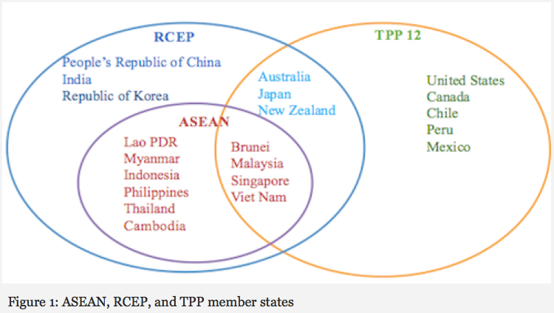
Notes:
http://asiafoundation.org/in-asia/2015/09/09/tpp-and-rcep-boon-or-bane-for-asean/

Slide 22
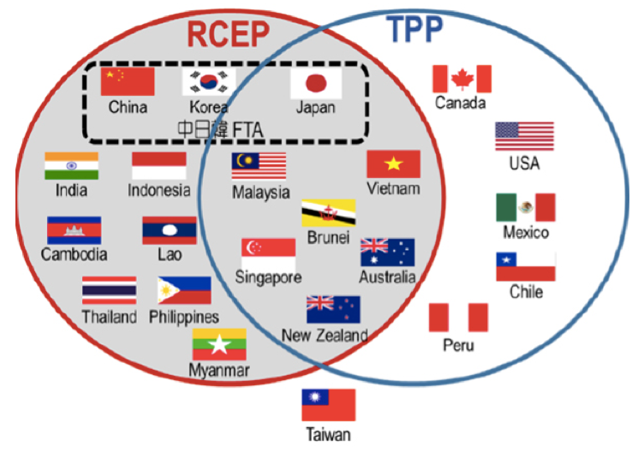
Notes:
http://www.postwesternworld.com/2015/08/21/tussle-regional-influence/

Slide 23
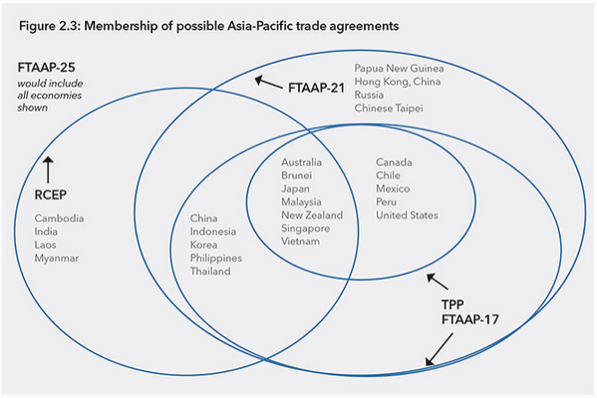
Notes:
http://www.pecc.org/state-of-the-region-report-2014/265-state-of-the-region/2014-2015/595-chapter-2-can-rcep-and-the-tpp-be-path-ways-to-ftaap

Slide 24
Implications of Mega-FTAs for China: TPP
If China does not join TPP
  Will suffer from trade diversion in countries without China FTAs
    US, Japan
    Others
  Will suffer from trade diversion due to ROOs even in countries with China FTAs
    Chile, Peru, members of ASEAN

Slide 25
Implications of Mega-FTAs for China: TPP
If China does not join TPP
  Will not be subject to non-trade requirements of TPP
    State owned enterprises
    Labor Standards
    Environment
  May not need to open trade as much as TPP requires

Slide 26
Implications of Mega-FTAs for China: RCEP
If RCEP, including China, succeeds
  Minimal trade creation/diversion, since China already has FTAs with ASEAN and some other RCEP members
    S Korea
    New Zealand
  Largest effect will be FTA with Japan
    Some trade creation
    Reversal of prior trade diversion from Japan’s other FTAs, including TPP.

Slide 27
Implications of Mega-FTAs for China: RCEP
If RCEP, including China, succeeds
  If it cumulates rules of origin, RCEP will reduce trade and investment diversion due to ROOs.
Though initiated by ASEAN, RCEP will be viewed as a political triumph of China in building a China-centered economic bloc.

